Slide 1
Advances in ICP-OES analysis and ED-XRF analysis of Soil & Plant Material
Meredith M. Daniel-Prowse – SPECTRO Analytical Instruments
MASTPAWG Meeting February 2023

Slide 2

ED-XRF for the analysis of Plant tissue
Plant Tissue Analysis
Why use XRF?
SPECTRO XEPOS
Plant Tissue Data
Summary
Notes:
Today we are going to discuss plant tissue analysis by XRF. So first, let’s discuss a bit as to why XRF compared to other techniques and some of its advantages. For our study, we used the SPECTRO XEPOS Energy Dispersive X-Ray Fluorescence spectrometer. We will discuss some of the technology behind this instrument that lends itself to provide accurate and precise measurements of samples such as those for plant tissue analysis. We will review the data from our recent application study, followed by a summary.

Slide 3
Why ED-XRF for Plant Tissue Analysis?
Sample Preparation – No Acid Digestion
  Samples are dried and ground
  Ground samples are then pressed into a pellet for analysis
  Faster and easier sample preparation
Non-destructive
  Pellet can be retained
  If no binder is used in making the pellet, then the same sample can be used for verification using ICP-OES or analysis using another analytical technique
Fast turnaround time
  If lab also runs soil analysis, the XRF can be used to analyze the plant tissue leaving the ICP-OES predominantly for soil testing.
Notes:
Traditionally, plant tissue analysis has been done using ICP-OES and ICP-MS. In order to analyze the samples using these techniques, it requires that the sample be digested to get the sample into solution for analysis. These digestions require mineral acids for digestion. For XRF analysis, acid digestion is not necessary. For XRF analysis, the typical sample preparation would be to dry and ground the sample. The ground samples could be analyzed as is depending on the particular elements of interest. For the best accuracy and precision, it would be recommended to take the ground samples and press it into a pellet. The drying step would be the longest, but of course, this would be necessary for both the ICP and XRF techniques. The grinding and pressing take less than 10 minutes making it faster than most acid digestions with less error and without the need for mineral acids.
The analysis is non-destructive. If a suitable desiccator is used for storage, the pellet could be retained. If the pellet is pressed neat, without binder, then the same sample could then be used for verification by ICP or used for another technique.
Many labs that are running plant tissues are also analyzing soil samples. In these cases, it may be possible to screen or obtain most of the relevant plant tissue result via XRF freeing up the ICP-OES for the analysis of more soil samples.

Slide 4

Plant Tissue Analysis by XRF
What elemental information can be determined by XRF
  Macronutrients – Potassium and Phosphorus
  Secondary Macronutrients - Sulfur, Magnesium, and Calcium
  Micronutrients – trace elements such as Cu, Zn, Mo, Mn, Fe, Cl may be determined by XRF
  Screening for toxic elements at trace levels can be determined
Notes:
Plant tissue analysis involves looking at wide range of elements. Macronutrients such as potassium, phosphorus, sulfur, magnesium and calcium are required to be in % levels in the plant. Micronutrients are nutrients that are needed at concentrations of less than 100ppm. Most of these micronutrients can be determined at the required levels using XRF. In addition, to examining the nutrients levels of the plants, it is possible to screen for toxic element that may be present.

Slide 5
Plant Tissue Study
35 standard reference botanical samples were obtained for analysis
  Samples contained various plant materials
    Hay
    Row crops
    Tree crops
    Vegetable crops
Samples were received dried and ground.
  A few samples with more course structure where further ground using IKA tube mill for 2 minutes
Pelletizing the samples
  8 grams of powdered and ground samples were prepared into 40mm pellets using 15tons of pressure
Notes:
For our plant tissue study, we started with 35 standard reference materials of various botanical origin. The plant materials contained a wide variety of plants including hays, row crops, tree crops, and vegetable crops. The reference materials were received already dried and ground. However, there were a few samples with a courser structure that required further grinding. This was accomplished using an IKA tube mill with a 2-minute grind time. Each of samples were prepared as 40mm pressed pellets using 8 grams of sample and pressing under 15tons of pressure.

Slide 6
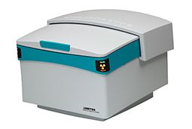
Instrumentation – SPECTRO XEPOS
Benchtop ED-XRF System
50 kV / 50 W Pd-Co alloy X-Ray tube with Adaptive Excitation
Covers the analytical range of Na – U
Large area high resolution SDD detector capable of capturing 1M counts per second with <130eV (Mn Kα) resolution
Sample trays accommodating 8 (with sample rotation), 12, or 25 samples.
Low limits of detection which can provide information about toxic elements as well as nutrient analysis
Notes:
For the analysis of these samples, we used the SPECTRO XEPOS Benchtop EDXRF system. Excitation of the system is accomplished using a 50kV/50W Pd-Co X-Ray tube combined with Adaptive Excitation system. With this excitation, we are able to cover the analytical range of sodium to uranium. The unit uses a large area, high resolution SDD detector that is capable of measuring 1M counts per second which maintaining resolutions less than 130eV at the Mn K-alpha line. The system can accommodate sample trays that can hold up to 25 samples. The combination of the SDD detector and our special optical system allows for low limits of detection that can provide information about both toxic elements as well as nutrients.

Slide 7
Latest Generation SDD Detector
New detection systems can handle 10 times higher count rates compared to earlier detection systems with resolutions <130eV (Mn Kα)
Precision of the analysis is a function of the counting statistics
  100 counts error 10 counts error 10 %
  10,000 counts error 100 counts error 1 %
  1,000,000 counts error 1000 counts error 0.1 %
New SDD Detection Systems can handle 10X higher count rates
  10 times higher count rates can lead to 3 times better precision
  10 times higher count rates can lead to 3 times lower LODs
Notes:
Newer detection systems have been a huge leap forward to EDXRF. As mentioned previously, the SPECTRO XEPOS’s detector is capable of measurement up to 1 million counts per seconds which is 10X higher count rates. If we look at the precision of the analysis as a function of counting statistics, it is clear to see as we go from 100 counts to 1 million counts, the counting statistics, there is an intrinsic error of 10% with 100 counts where for the 1 million counts, the error is greatly reduced to 0.1%. The more counts we can get to the detector, the tighter the precision on the measurement. As a result of the higher count rates, the 10X improvement will lead to 3X better precision and it can lead to 3X lower limits of detection.

Slide 8
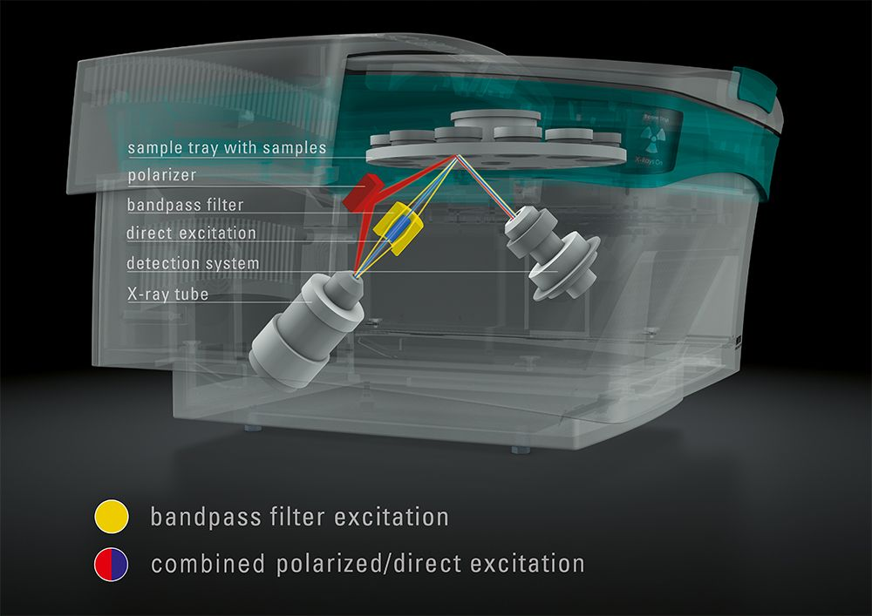
New Excitation Strategy
New adaptive excitation
  Direct Excitation
    X-Ray tube with a thick Pd-Co alloy anode
    Direct Excitation can be achieved with both Pd and Co lines
  Use of band-pass filter
    Combined with Co K-line excitation for best sensitivity for K-Mn K-lines
  Use of HAPG polarizer
    Combined with Direct Excitation of Pd L-lines provides best sensitivity for light elements (Na-U)
Notes:
In order to harvest the benefits of the high count rate SDD detectors, it was necessary to develop new excitation strategy. A new adaptive excitation was developed. The excitation comes with up to 3 different excitation conditions. First, there is direct excitation. But at the heart of the system is a new 50W tube utilizing a binary alloy anode made of Pd and Co. By adjusting the tube voltage, it is possible to directly excite the sample using from Co K-line, Pd K-line, Pd L-lines for light elements, or with the bremsstrahlung. This gives a great deal of flexibility for the optimal excitation of different groups of elements. The second form of excitation is the use of the first commercially implemented bandpass filter. This providse monochromatized excitation of the Co K- line which leads to lower detection limits and improved sensitivity. Lastly, combined polarized / direct excitation using a HAPG polarization filter. The use of the polarization filter greatly improves the excitation of the light element compared to direct excitation alone.

Slide 9
Instrumentation Conditions
Elements | Tube kV/mA | Excitation Mode | Measurement Time *
Na – Cl (K-lines) | 22.5 / 2.0 | Polarization | 300 s
K-Mn (K-lines) Pr –Sm (L-lines) | 22.5 / 2.0 | Bandpass Filter | 150 s
Fe – Nb (K-lines) Yb – U (L-lines) | 45.0 / 1.0 | Direct Excitation | 150 s
Mo – Ce (K-lines) | 50.0 / 0.8 | Direct Excitation | 150 s
* Measurement time = clock time, live time is about 50% shorter than given measurement time
All measurements were done under vacuum.
Notes:
The measurement conditions used for the plant tissue study are listed above. All measurements were done in vacuum as the samples had been prepared as pressed pellets. The instrument can be equipped with helium purge for samples that may be analyzed as loose powders. Measurement times can be lengthen or shorten depending on the analytical needs of the application.

Slide 10
Calibration
35 botanical reference materials were used
Calibration is based on Fundamental Parameters approach
Element | Range of Calibration (µg/g) | R²
Na | 298.8 – 29187.8 | 0.9997
P | 665.5 – 5994.5 | 0.9836
K | 8245.6 - 100004 | 0.9984
Ca | 1672.7 – 31828.4 | 0.9941
Mn | 33.8 – 738.1 | 0.9993
Fe | 74.4 – 4241.8 | 0.9998
Cu | 1.9 – 83.3 | 0.9975
Zn | 18.3 – 266.1 | 0.9985
Notes:
As mentioned previously, 35 botanical reference standards were used for analysis. The calibration was accomplished using a fundamental parameters approach. The table shows the range of calibration for some more important elements as well as the correlation coefficient. You can see that good correlation is achieved for all of these elements.

Slide 11
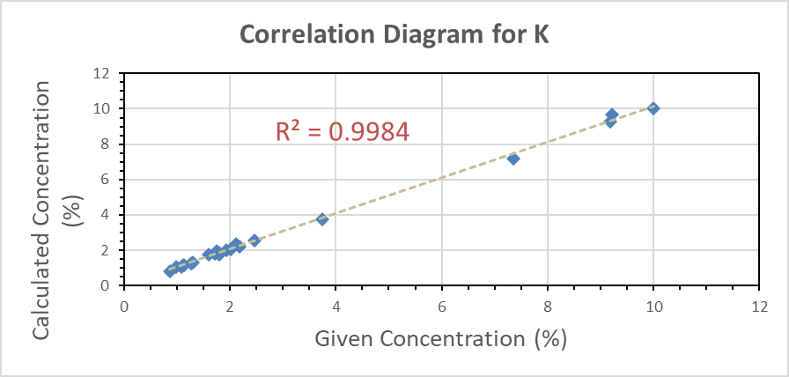
Correlation Plots

Slide 12
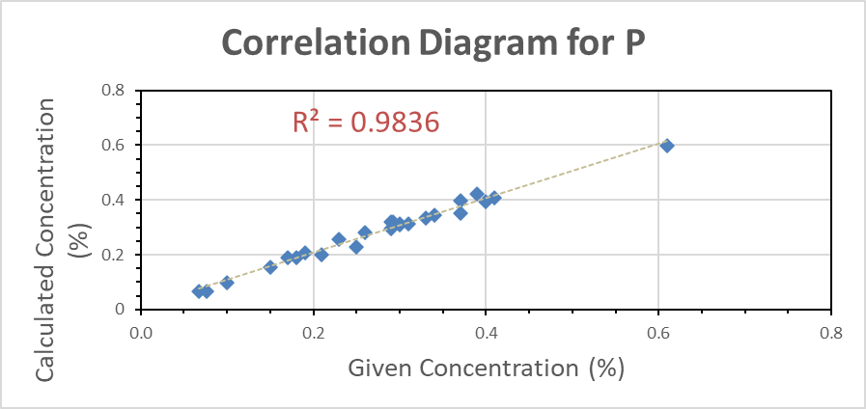
Correlation Plots

Slide 13
Validation – Raye Grass WEPAL IPE 154
Informational values are shown in italic
Notes:
For validation of the calibration, two additional reference standards were used. Here we have the WEPAL 154 standard of Raye grass. You can see that good agreement is achieved for all the important nutienet elements such as phosphorus, sulfur, manganese as well as some toxic elements such as Pb and As.

Slide 14
Validation – Spinach Leaves - NIST 1570a
Informational values are shown in italic
Notes:
The second of the standards for validation is the NIST 1570a Spinach Leaves sample. Again good agreement between the certified values and the calculated results.

Slide 15
Precision
Repeatability conducted on NIST 1570a
Notes:
The NiST 1570a sample was also measured 10 times to demonstrate the precision that is capable on the XEPOS. You can see the excellent precision that achieved. For the % level elements shown here, %RSD are all less than 1%.

Slide 16

Summary
ED-XRF is suitable for the analysis of plant tissues.
SPECTRO XEPOS provides
  Fast
  Accurate
  Nondestructive
  High Precision Analysis
  Required for:
  Primary nutrients of P and K
  Secondary Macronutrients – Ca, Mg, S
  Micronutrients (except B)
  As well as possible toxic elements

Slide 17
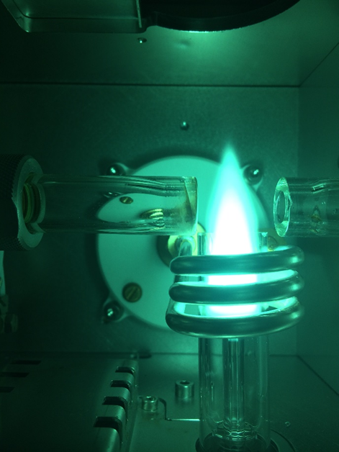
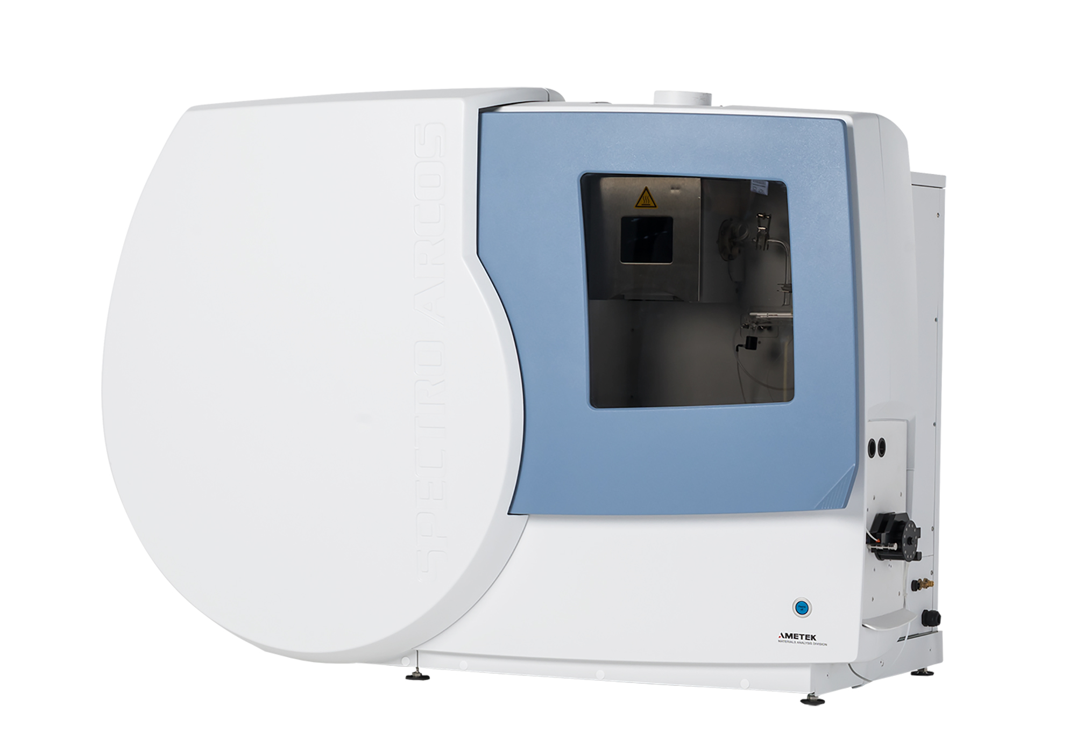
ICP Analysis of Soils using
DSOI (Dual Side-On Interface)

Slide 18
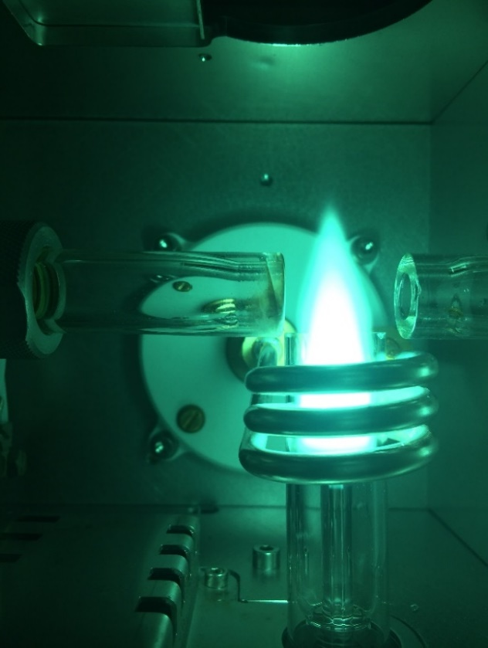
Dual Side-On Plasma Observation – How does it work?
Since the light emitted into two directions is transferred into the optical system the sensitivity is in average improved by a factor of two
In addition, the vertical torch provides high stability and freedom from matrix effects since the affected zones in the plasma are blanked out
Pros and Cons:
  High stability
  High matrix tolerance
  High linear dynamic range
  Freedom from matrix effects
  All with one measurement
  Axial performance/Radial Robustness
Plus
  As sensitive as an Echelle based axial/dual view system
  since there are no additional absorption in the primary light path!
Viewing volume x 2
Notes:
Maybe try to collect more of the emitted light without an interface on top of the plasma! Dual side-on plasma observation, in addition to a standard radial interface does exactly that. It also collects the light from the opposite side of the plasma and transfers that light through the side-on plasma interface into the optical system. The benefit: an up to factor two sensitivity gain, while maintaining all the benefits of the vertical torch radial plasma observation technique.
Even though the sensitivity is not 100% the same, when compared to direct path axial observation, the difference is small, only about a factor two.
However, compared to the newer vertical torch dual view systems this technology provides a sensitivity on the same level… and… no interface above the plasma and no requirements for an additional measurement.

Slide 19
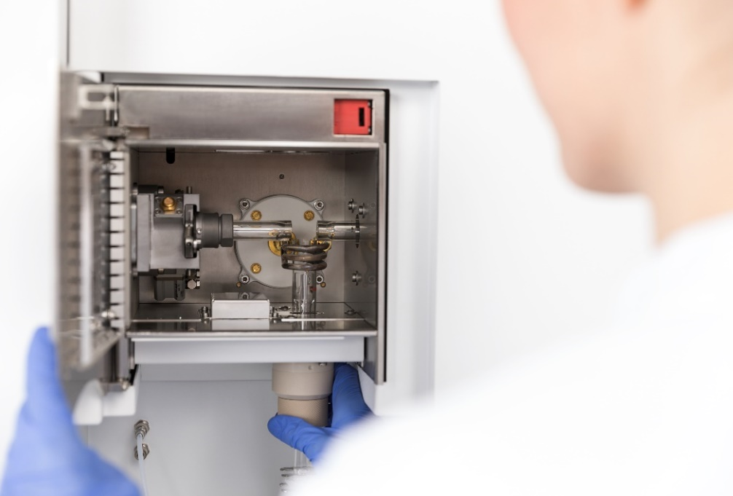
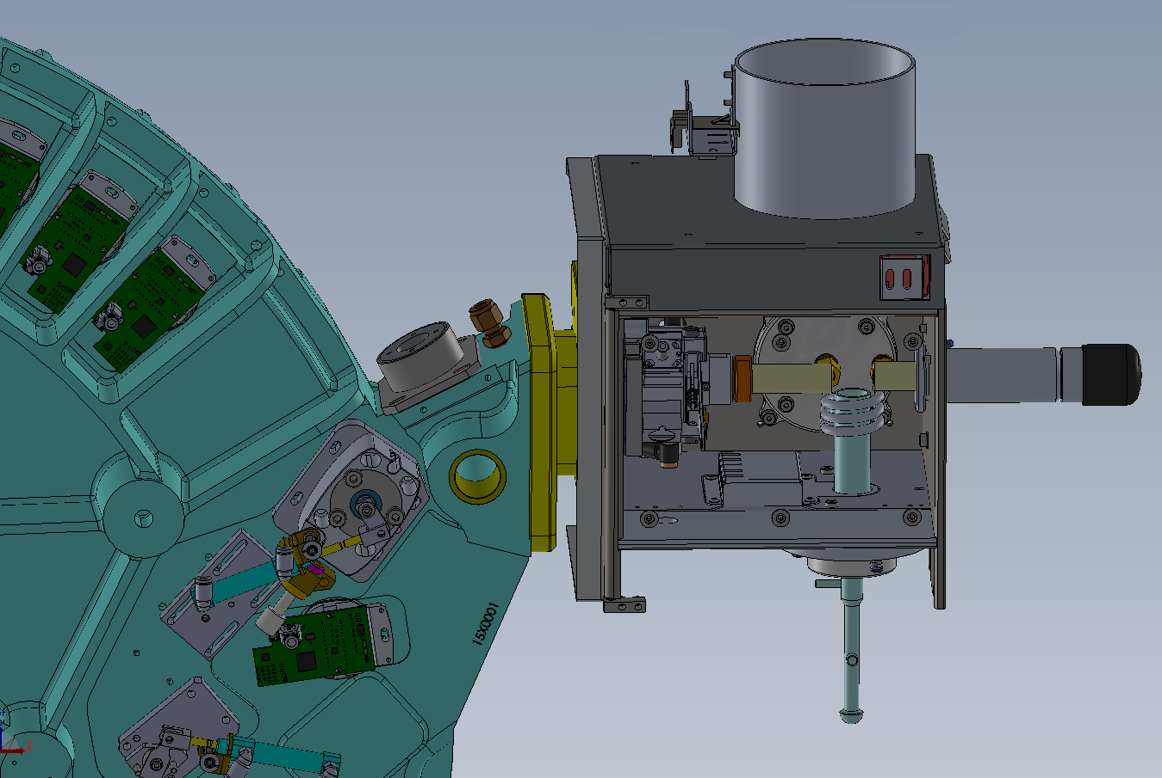
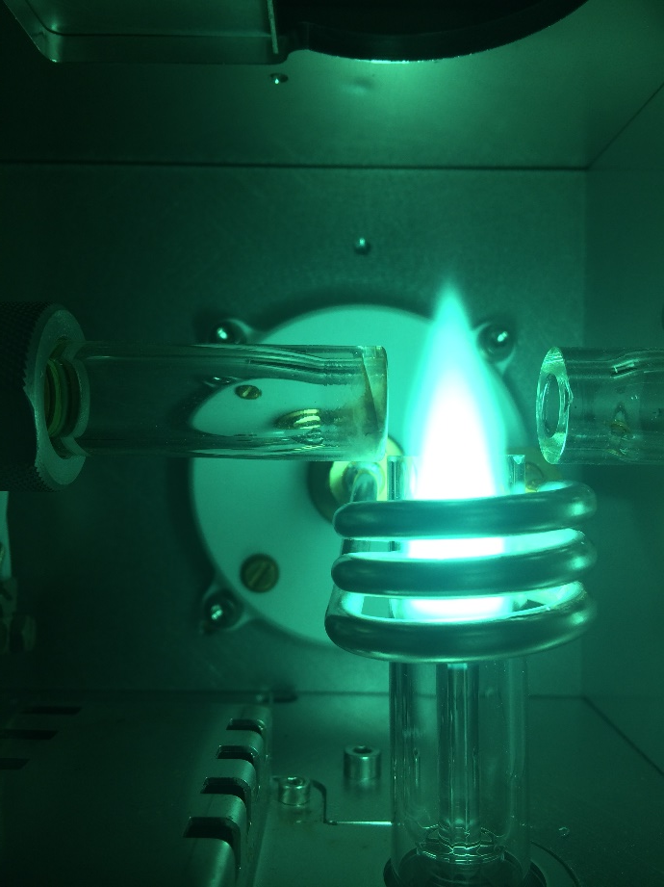
Dual Side-On Interface
Notes:
The slide shows how this has been technically realized in the new SPECTROGREEN, introduced beginning of this year. In addition to the side on interface, flanged to the optical system to ensure perfect alignment, an additional, Ar purged light tube is installed on the right-hand side. At the end of this tube, a concave mirror is installed, which reflects the emitted light back through the plasma into the side on interface. The mirror is mounted inside a screw cap. To maintain, only the cap needs to be changed.

Slide 20
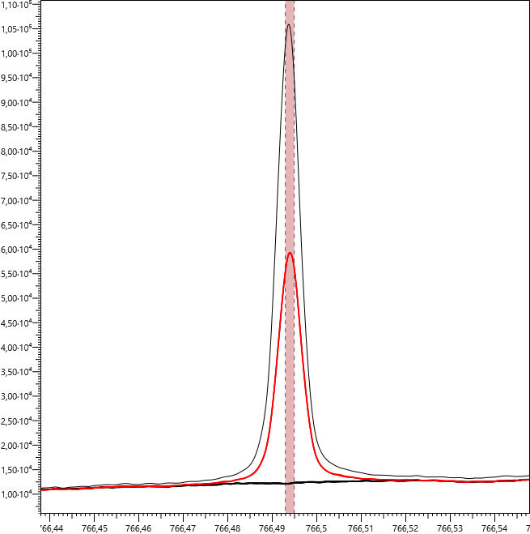
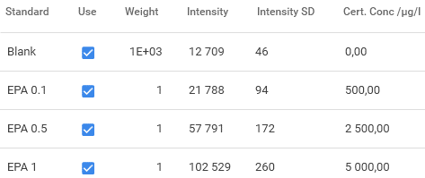

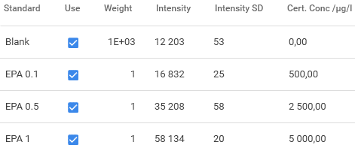

How is the Sensitivity Gained? - Potassium
GREEN DSOI
BEC improvement factor: 1.9
LOD Improvement factor: 2.3
GREEN SOP
Notes:
The improvement depends on the element and as the example of Potassium on this slide demonstrates, also a gain beyond a factor of two is possible.

Slide 21
Sensitivity Comparison Dual versus Single Side-On
 |  | Single Side-On SOP | Dual Side-On DSOI | SOP/DSOI |  | Axial | DSOI | Axial/DSOI
 | nm | LOD [µg/L] | LOD [µg/L] | Factor |  | LOD [µg/L] | LOD [µg/L] | Factor
Ag | 328.068 | 1.32 | 0.39 | 3.42 |  | 0.51 | 0.39 | 1.32
Al | 167.078 | 0.14 | 0.03 | 4.39 |  | 0.05 | 0.03 | 1.53
As | 189.042 | 1.65 | 1.31 | 1.26 |  | 0.81 | 1.31 | 0.62
As | 193.759 | 2.67 | 1.99 | 1.34 |  | 0.95 | 1.99 | 0.48
Ba | 455.404 | 0.07 | 0.03 | 2.14 |  | 0.05 | 0.03 | 1.49
Be | 313.042 | 0.04 | 0.02 | 2.58 |  | 0.03 | 0.02 | 1.98
Ca | 396.847 | 0.06 | 0.02 | 3.31 |  | 0.02 | 0.02 | 1.08
Ca | 315.887 | 3.13 | 1.17 | 2.68 |  | 0.79 | 1.17 | 0.68
Cd | 214.438 | 0.10 | 0.08 | 1.22 |  | 0.04 | 0.08 | 0.50
Cd | 226.502 | 0.16 | 0.11 | 1.47 |  | 0.06 | 0.11 | 0.55
Co | 228.615 | 0.32 | 0.20 | 1.54 |  | 0.12 | 0.20 | 0.59
Cr | 267.716 | 0.30 | 0.27 | 1.09 |  | 0.15 | 0.27 | 0.55
Cu | 324.754 | 0.74 | 0.29 | 2.60 |  | 0.31 | 0.29 | 1.08
Fe | 259.941 | 0.18 | 0.22 | 0.83 |  | 0.08 | 0.22 | 0.36
Hg | 194.227 | 1.02 | 0.56 | 1.81 |  | 0.42 | 0.56 | 0.75
K | 766.491 | 50.63 | 8.45 | 5.99 |  | 1.7 | 8.45 | 0.20
Li | 670.784 | 1.07 | 0.28 | 3.86 |  | 0.04 | 0.28 | 0.14
Mg | 279.553 | 0.06 | 0.02 | 2.82 |  | 0.005 | 0.02 | 0.25
Mg | 280.270 | 0.06 | 0.02 | 3.26
Mn | 257.611 | 0.05 | 0.04 | 1.36 |  | 0.03 | 0.04 | 0.84
Mo | 202.095 | 0.28 | 0.24 | 1.20 |  | 0.15 | 0.24 | 0.64
Na | 589.592 | 6.01 | 2.01 | 2.98 |  | 0.4 | 2.01 | 0.20
P | 177.495 | 1.55 | 0.95 | 1.63 |  | 0.59 | 0.95 | 0.62
P | 178.287 | 1.99 | 1.37 | 1.45 |  | 0.79 | 1.37 | 0.58
Pb | 220.351 | 1.92 | 1.60 | 1.20 |  | 0.68 | 1.60 | 0.42
Sb | 206.833 | 1.85 | 1.31 | 1.41 |  | 0.87 | 1.31 | 0.66
Se | 196.090 | 2.52 | 2.15 | 1.17 |  | 0.98 | 2.15 | 0.46
Sn | 189.991 | 1.23 | 0.53 | 2.29 |  | 0.28 | 0.53 | 0.52
Sr | 407.771 | 0.04 | 0.01 | 3.56 |  | 0.01 | 0.01 | 0.91
Tl | 190.864 | 5.35 | 1.23 | 4.33 |  | 0.59 | 1.23 | 0.48
V | 311.071 | 1.24 | 0.35 | 3.56 |  | 0.46 | 0.35 | 1.32
Zn | 213.856 | 0.10 | 0.07 | 1.39 |  | 0.05 | 0.07 | 0.71
 |  |  | Average | 2.35 |  |  | Average | 0.73
Clearly improved sensitivity compared to the single side on (∅ factor 2.35)
  Biggest effect for alkali/earth for alkali elements
Even when compared to the direct path axial observation there is not a big difference
(∅ factor 0.73)
  Again the alkali/earth for alkali elements show the highest improvement using the axial view
  For Routine work the remaining factor is marginal
  The huge advantages of the vertical torch, radial interface of the DSOI likely outweigh the sensitivity differences for many applications
Notes:
When compared with single side-on observation an average improvement factor of 2.35 is obtained with the biggest gain for the alkali and the earth alkali elements. When compared with direct light path axial observation there is not a big difference, anymore. For many routine tasks this difference should be marginal, particular when considering the huge benefits…vertical torch radial interface….drastically reduced matrix interferences…better precision and stability… only a single plasma view analyzes…no contaminated interfaces…and less maintenance.

Slide 22

Soil - Plasma and Measurement Parameters
Element | Std.1 [mg/L] | Std.2 [mg/L] | Std.3 [mg/L] | Std.4 [mg/L] | Std.5 [mg/L] | Std.6 [mg/L]
Ag | 0 | 0.1 | 0.25 | 0.5
Al | 700 | 600.4 | 501 | 402 | 300 | 200
As | 0 | 0.4 | 1 | 2 | 20 | 30
B | 0 | 0.4 | 1 | 2
Ba | 0 | 0.4 | 1 | 2
Be | 0 | 0.4 | 1 | 2
Ca | 1000 | 1100.4 | 1301 | 1502 | 1800 | 1400
Cd | 0 | 0.4 | 1 | 2 | 0.5 | 0.1
Co | 0 | 0.4 | 1 | 2
Cr | 0 | 0.4 | 1 | 2 | 5
Cu | 0 | 0.4 | 1 | 2 | 10 | 20
Fe | 400 | 500.4 | 601 | 702 | 450 | 550
Hg | 0 | 0.4 | 1 | 2
K | 0 | 2 | 5 | 10 | 20 | 50
Li | 0 | 0.4 | 1 | 2 | 10
Mg | 200 | 100.4 | 51 | 2 | 10
Mn | 0 | 0.4 | 1 | 2
Mo | 0 | 0.4 | 1 | 2
Na | 50 | 10.4 | 1 | 2
Ni | 0 | 0.4 | 1 | 2
P | 800 | 602 | 205 | 410 | 100 | 50
Pb | 0 | 0.4 | 1 | 2 | 10
Sb | 0 | 0.4 | 1 | 2
Se | 0 | 0.4 | 1 | 2
Si | 0 | 0.4 | 1 | 2
Sn | 0 | 0.4 | 1 | 2
Sr | 0 | 0.4 | 1 | 2
Tl | 0 | 0.4 | 1 | 2
V | 0 | 0.4 | 1 | 2
Zn | 0 | 0.4 | 1 | 2 | 10
The matrix composition and amount of TDS in the final solution can be high vary strongly:
    Ca 3000 mg/l Mg 500 mg/l
    Al 1000 mg/l Fe 1000 mg/l
    Na 100 mg/l K 100 mg/l - (%)
    P 1000 mg/l-(%) N -%
Major elements traces to be determined
Power | 1100 W
Observation Mode | Dual-Side-On
Coolant flow | 13.0 L/min
Auxiliary flow | 0.80 L/min
Nebulizer flow | 0.93 L/min
Plasma Torch | Quartz, fixed, 1.8 mm Injector tube
Spray Chamber | Scott
Nebulizer | Cross Flow
Sample aspiration rate | 2 mL/min
Replicate read time | 44 s per replicate
Notes:
Now, everyone can analyze water and in such an “easy” matrix naturally the interface shows a nice sensitivity improvement. A tougher matrix are agronomy samples (soil, plants and fertilizer). Even though typically not extremely line rich, it needs to be noted that the matrix composition can vary considerably and so does the amount of totally dissolved solids in the final solution to be analyzed. Variations from sample to sample are not uncommon and the slide here gives overview of some of the major elements and concentration ranges which can be expected.
To cater for the matrix, which may contain undissolved particles, a more robust Cross Flow nebulizer and a modified (smaller size) Scott type spray chamber was used. This setup does not provide the highest sensitivity since the cross flow is not quite as efficient than a Seaspray. However, unlike concentric nebulizers, they are less likely to clog and while it uses a relatively short Platinum Iridium capillary, there is even the chance to manually clean the capillary using a soft copper wire. The compact Scott chamber provides good stability on one hand and short wash out due to a smaller wetted surface on the other.

Slide 23
Soil - LODs and Recoveries (BCR-320R)
Element | Certified Concentrations [mg/kg] | Measured Concentrations [mg/kg] |  |  | Recovery [%]
 |  | Analysis No. 1 | Analysis No. 2 | Analysis No. 3 | Analysis No. 1 | Analysis No. 2 | Analysis No. 3
As | 21.7 ± 2.0 | 23.0 | 22.7 | 22.8 | 106.0 | 104.6 | 105.1
Cd | 2.64 ± 0.18 | 2.63 | 2.61 | 2.59 | 99.6 | 98.9 | 98.1
Co | 9.7 ± 0.6 | 9.45 | 9.37 | 9.29 | 97.4 | 96.6 | 95.8
Cu | 46.3 ± 2.9 | 45.4 | 44.7 | 44.1 | 98.1 | 96.5 | 95.2
Fe | 25700 ± 1300 | 2.45E+04 | 2.46E+04 | 2.45E+04 | 95.5 | 95.8 | 95.2
Hg | 0.85 ± 0.09 | 0.855 | 0.876 | 0.875 | 100.6 | 103.1 | 102.9
Mn | 910. ±50 | 881 | 877 | 871 | 96.8 | 96.4 | 95.7
Ni | 27.1 ±2.2 | 25.2 | 26.0 | 25.1 | 93.0 | 95.9 | 92.6
Pb | 85 ± 5 | 86.7 | 87.0 | 85.8 | 102.0 | 102.4 | 100.9
Se* | 0.96 ± 0.18 | 0.834 | 0.857 | 0.875 | 86.9 | 89.3 | 91.1
Sn* | 9.4 ± 1.7 | 8.50 | 8.33 | 8.31 | 90.4 | 88.6 | 88.4
V | 46.5 ± 2.8 | 44.4 | 44.6 | 43.9 | 95.5 | 95.9 | 94.4
Zn | 319 ± 20 | 311 | 312 | 308 | 97.5 | 97.8 | 96.6
 | λ [nm] | DSOI LOD (3σ) [mg/kg] | Axial LOD (3σ) [mg/kg] |  | λ [nm] | DSOI LOD (3σ) [mg/kg] | Axial LOD (3σ) [mg/kg]
Ag | 328.068 | 0.06 | 0.035 | Mn | 257.611 | 0.01 | 0.01
As | 189.042 | 0.23 | 0.21 | Mo | 202.095 | 0.08 | 0.06
B | 249.677 | 0.05 | 0.1 | Ni | 221.648 | 0.05 | 0.03
Ba | 455.404 | 0.01 | 0.006 | Pb | 220.353 | 0.4 | 0.2
Be | 313.042 | 0.002 | 0.002 | Sb | 206.833 | 0.5 | 0.4
Cd | 228.802 | 0.02 | 0.01 | Se | 196.090 | 0.5 | 0.4
Co | 228.616 | 0.04 | 0.02 | Sn | 189.991 | 0.14 | 0.1
Cr | 267.716 | 0.04 | 0.03 | Sr | 407.771 | 0.007
Cu | 324.754 | 0.06 | 0.03 | Tl | 190.864 | 0.4 | 0.2
Hg | 184.950 | 0.08 | 0.07 | V | 311.071 | 0.05 | 0.05
K | 766.491 | 1.2 | 0.05 | Zn | 213.856 | 0.03 | 0.03
Li | 670.780 | 0.04 | 0.003
Sample dilution: 1:33 (0.75g/25ml)
* non-certified concentration, indicative value only
Notes:
Also for soil, with even higher matrix levels, still the sensitivity is improved by 60% compared to the single radial plasma observation. But also compared to direct axial view there is very little difference, as the values in table demonstrate. Only exception are the alkalis, which naturally show a much higher sensitivity using the axial technique.
To test accuracy, the solid reference material BCR 320R was digested three times using microwave digestion according to European standard EN 16174. The measured concentrations and the recoveries of the certified values are presented in right table. The comparison shows, that the triple determination is in perfect agreement with the given values for all elements.
It also demonstrates the excellent linearity of the instrument. Even though the concentration for Mn in the reference material was approximately ten times higher than the highest calibration standard, the concentrations were still recovered, well.

Slide 24
Thank you for your attention
For more information: www.spectro.com

